Slide 1
Six Sigma Yellow Belt/ Six Sigma Green Belt Exam questions and answers with explanation
Presented by
Tanmoy Das
Certified Six Sigma Green Belt, American Society for Quality
Trained on Quality Improvement Associates, AMTC, Tallahassee, Florida

Slide 2

Question:
Answer:
Explanation:
Quality Basic

Slide 3
Question: Quality and the Critical-to-Quality (CTQ's) are both subjective terms that are defined by the _______________. Management team Line Supervisor Customer Design team
Answer: 3
Explanation:
Quality Basic

Slide 4
Question: Which of the following tools indicates a relationship between X and Y variables, and provides a visual correlation coefficient. Cause (X) and Effect (Y) Diagram Pareto Chart Scatter Diagram Control Chart
Answer: Scatter Diagram
Explanation:
Data Visualization

Slide 5
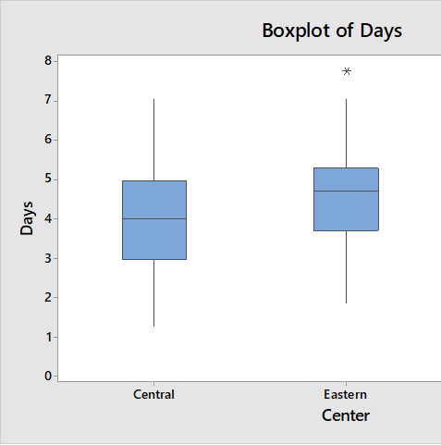
Question: Box Plot Graph is used to_______________________ . [multiple choice] 1. Identify outliers 2. Differentiate before and after Improvements. 3. It is suited for time ordered data and parametric distribution. 4. B and C only
Answer: 1&2
Explanation:
Data Visualization

Slide 6
Question: You are a Project Manager wanting to compare on time delivery (%) of Team Leads across 3 teams, your choice of technique would be? Hypothesis Testing Histograms Pareto chart Box Plots
Answer: 4
Explanation:
Data Visualization

Slide 7
Question: What kind of Graph would help us to analyze stability of non parametric (NO assumption) distribution of data points P Chart I-mR Chart C Chart Box Plot
Answer: Box Plot
Explanation: Assumption free/ distribution free data
Data Visualization

Slide 8
Question: The distance between Quartile1 (Q1) and Quartile3 (Q3) is called as __________ and it helps to understand ___________ of process variation. Inter Quartile Range and Width Quartile Range and Height Quartile 2 and Width Median and Width
Answer: 1
Explanation:
Data Visualization

Slide 9
Question: The Pareto Graph is used to represent ____________ scale of measurement. Nominal Ordinal Ratio Interval
Answer: Nominal
Explanation:
Nominal (e.g. label, Roll Number), least exact info
Ordinal (e.g. rank, 1st / 2nd boy in the class)
Interval (e.g. grading in the exam( 81 or 83 is the same)
Ratio (e.g. mark in the exam), more exact
Data Visualization

Slide 10
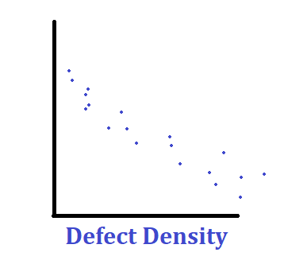
Question: In a project, defect density increases and Productivity decreases in subsequent releases. Indicate what kind of relationship that you can interpret in this pair (x, y)? Weak Positive Correlation Strong Negative Correlation No relation Strong Positive Correlation
Answer: Strong Negative Correlation
Explanation:
Productivity
Data Visualization

Slide 11
Question:
Answer:
Explanation:
Data Visualization

Slide 12
Question: Which of the following are characteristics of the inputs to a process? [Multiple choice] These are referred to as the x variables These are the "causes" that create the effect A process output is a function of its inputs None of the above
Answer: 1,2,3
Explanation:
Basic Statistics

Slide 13
Question: Six Sigma is a term used to indicate that there are 6 Standard Deviations below and above the process Mean and within upper and lower specification limits. True False
Answer: True
Explanation:
Basic Statistics

Slide 14
Question: What is the percentage of perfection in a process operating at +/- 3 Sigma level 99.999660 % 99.999999. % 99.976700 % 3.4 DPMO
Answer: 99.976700 %
Explanation:
Basic Statistics

Slide 15
Question: Which of the following is NOT an advantage of using a median? 1. Extreme values do not affect the median as strongly as they affect Mean 2. A median can be calculated for qualitative descriptions 3. Median is easy to understand 4. Median can be calculated even for open-ended classes
Answer: 4
Explanation:
Basic Statistics

Slide 16
Question: Which of the following is not a Measure of Central Tendency Geometric Mean Median Mode Arithmetic Mean
Answer: Geometric Mean
Explanation:
Consider 1,2,3,5,-1,0
Basic Statistics
Notes:
Which of the following is NOT an advantage of using a median?
Extreme values do not affect the median as strongly as they affect Mean
A median can be calculated for qualitative descriptions
Median is easy to understand
Median can be calculated even for open-ended classes
More Quizzes

Slide 17
Question: Ratio and Interval Scale of measurements are based on ______________type of data Discrete & Attribute Discrete & Continuous Variable & Continuous Continuous & Attribute
Answer: variable & Continuous
Explanation:
Basic Statistics

Slide 18
Question: The Graph which helps to identify and prioritize problems to be solved Control Chart Histogram Chart Fish Bone Graph Pareto Chart
Answer: Pareto Chart
Explanation:
7 tools of Quality

Slide 19
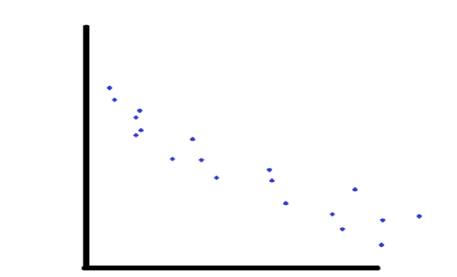
Question: The design and code review effort is high (process is effective) in a project, and it results in less number of defects injected in UAT phase. Identify the appropriate type of correlation between review effort and number of defects. (Assume that "r" value is good). Positive Correlation Strong Negative Correlation Non linear Correlation Strong Positive Correlation
Number of defect
Answer: Strong Negative Correlation
Explanation:
Effort
Data Visualization

Slide 20
Question: If the effort variance of your project shows a negatively skewed normal distribution curve, what will you infer from the following? This means that the project is proactively finishing ahead of time Project is in control Project is influenced by lot of special causes None of the above
Answer: 1, finish early
Explanation:
Basic Statistics

Slide 21
Question: --------------------- helps to understand Process behavior for parametric distribution. Median Range Mean Variance
Answer: Mean
Explanation:
Basic Statistics

Slide 22
Question: "If P value is >=0.5, then the process is said to be Normal" – Indicate what type of statistics is being used? Descriptive Inferential Expression None of the above
Answer: Inferential
Explanation:
Basic Statistics

Slide 23
Question: Three Standard Deviations on left and right side of the mean would include what % of the total data points in Normal Distribution? 68 % 97 % 99 % 95 %
Answer:
Explanation:
Basic Statistics

Slide 24
Question: In your project, Review effort (hrs, X) and defect rate (no. of defects per hour, Y) show a negative correlation. It means : As Defect rate increases, Review effort also increases Negative correlation does not infer any relationship between Review effort and defect Factors As Defect Rate decreases, Review effort also decreases As Defect Rate increases, Review Effort Hrs decreases
Answer: As Defect Rate increases, Review Effort Hrs decreases
Explanation:
Data Visualization

Slide 25
Question: If you are a Team Lead encountering a positively skewed normal distribution curve for Defect Leakage Rate, then what will you conclude from the following? Process is stable Process is within limits Process needs Corrective action over Defects Process is influenced by special cause variation
Answer: Process needs Corrective action over Defects
Explanation:
Data Visualization

Slide 26
Question: The measure which helps to understand the spread of variation is called as __________ Quartile 1 Cpk Mode Variance
Answer: Variance
Explanation:
Basic Statistics

Slide 27
Question: One of the most popular measures of variability in a data set or population is ______________. Dispersion Variation Mean Standard Deviation
Answer: SD
Explanation:
Basic Statistics

Slide 28
Question:
Answer:
Explanation:
Basic Statistics

Slide 29
Question: ___________________determines the nature of relationship which would help us to make predictions. Correlation Analysis Regression Analysis Stability Analysis Capability Analysis
Answer: Regression
Explanation:
Basic Statistics

Slide 30
Question: A software development process has UAT Defect density as Y, percent review effectiveness as X1 and percent design phase effort as X2. Indicate the type of regression model Y= -0.1320 X1 + 0.16 X2 + 23.200 Single Linear Regression Dummy Variable Regression Multi Linear Regression Logistic Regression
Answer: Multi Linear Regression
Explanation:
Regression

Slide 31
Question: Which of the below statistical tests helps in decision making based on data inferences? Mode Hypothesis Test Skewness Stability Test
Answer: 2
Explanation:
Analyze Phase: Hypothesis

Slide 32
Question: What is the outcome of Hypothesis Testing, where P Value > = 0.05 ? Accept Alternate Hypothesis Reject Null Accept Null Hypothesis Data is normal
Answer:
Explanation:
Analyze Phase: Hypothesis

Slide 33
Question:
Answer:
Explanation:
Data Visualization

